Slide 1
BERToid
By: Its GIF not GIF
Smart Lightweight Medical Query System (SLiMQ)

Slide 2
What are we solving
A smart medical QA system to aid doctors that doesn’t hallucinate
Lightweight enough to run on off-the shelf devices (Eg: mobile phones)

Slide 3
Approach
Read the “Question Answering with Long Multiple-Span Answers by Ming Zhu et al.” which introduced the idea of comparing the context’s sentence similarity with the query as well as similarity with other sentences.
Even though the paper claimed this method was suboptimal, this felt the most approachable for a hackathon.

Slide 4
Approach #1: Fine tune LLAMa on the MASHQA dataset
- The instruction prompt to LLAMA would be the query and the context and the target was the correct answers.

Slide 5
Approach #1: Fine tune LLAMa on the MASHQA dataset
- The instruction prompt to LLAMA would be the query and the context and the target was the correct answers.
- Challenge: Token limit of LLAMA

Slide 6
Approach #1: Fine tune LLAMa on the MASHQA dataset
- The instruction prompt to LLAMA would be the query and the context and the target was the correct answers.
- Challenge: Token limit of LLAMA
- Solution: Chunk the context and concatenate individual results using langchain or smtg similar.

Slide 7
Problem with the approach
Quantized LLAMA with less than a billion parameters is still unreasonably slow on a CPU.
Took 2 minutes to print one token locally (unacceptable)

Slide 8
Approach #2: Use BERT
- Use BERT which is a relatively smaller model
- Get the similarity scores between each sentence of the context and the query.
- Print the sentences which are above some threshold of similarity

Slide 9
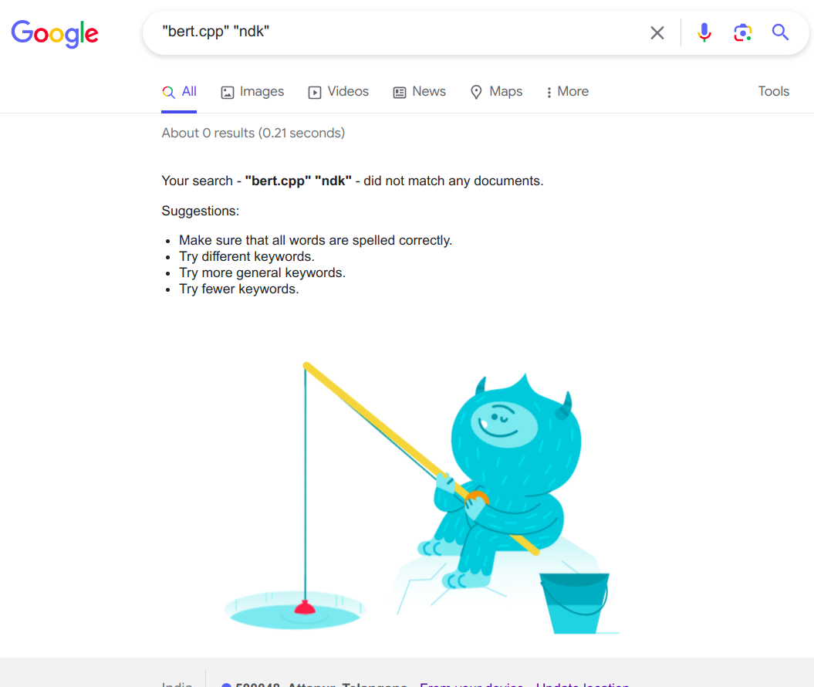
Major challenge

Slide 10
Ported bert.cpp to android
It can run using termux

Slide 11
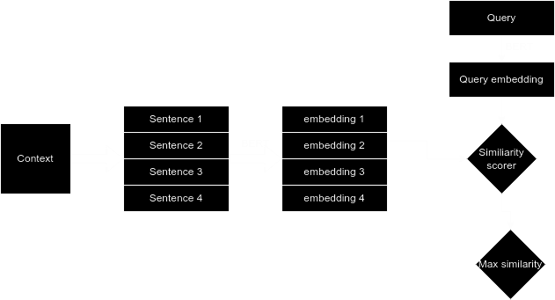
Flow Chart

Slide 12

Demo

Slide 13
thank you!!

